Slide 1


Advanced Cybersecurity Engineering & Enterprise Information Security Strategy
Travellers Beach Hotel, Mombasa
Computer Society of Kenya (CSK)
2026 Executive Series

Slide 2

Executive Program Roadmap
Modules 1 - 3: Foundations & Intelligence
Modules 4 - 6: Defense & Operations
Module 4: Practical Security Controls and Modern Tools
Module 1: The Role of Encryption in Data Security
Module 2: Advanced Risk Assessment Methodologies
Module 5: Strategic Incident Response Planning (IRP)
Module 3: Threat Intelligence & Vulnerability Management
Module 6: Business Continuity & Disaster Recovery (BCDR)
CSKMombasa
Agenda Overview
Slide 2 / 46

Slide 3

MODULE 01
The Role of Encryption in Data Security
Securing enterprise data at rest, in transit, and in processing using advanced mathematical cryptography and modern encryption protocols.

Slide 4
Core Cryptography Concepts
Symmetric Cryptography
Asymmetric Cryptography
Employs a single, shared secret key for both the encipherment and decipherment of data. Requires secure key distribution channels.
Utilizes mathematically linked key pairs: a Public Key for encipherment (widely shared) and a Private Key for decipherment (kept secret).
High throughput and processing speed
Eliminates physical key exchange issues
Standard algorithm: AES-256 (GCM/CBC)
Standard: RSA-4096, ECC (ECDSA)
CSKMombasa
Module 1: Encryption
Slide 4 / 46

Slide 5
Symmetric Encryption Modes
Encryption Mode | Basic Architecture | Parallel Processing | Primary Operational Use Case
ECB (Electronic Codebook) | Encrypts each block individually with the same key | Supported (Independent blocks) | Legacy database fields only (Insecure; leaks patterns)
CBC (Cipher Block Chaining) | Chains blocks sequentially using IV and XOR operations | Unsupported (Sequential dependency) | Legacy system storage volume protection
GCM (Galois/Counter Mode) | Counter mode with integrated authenticated tags | Highly Supported (Parallelizable) | Modern standard for high-speed TLS 1.3 tunnels
CTR (Counter Mode) | Converts standard block cipher into a stream cipher | Highly Supported (Parallelizable) | High-throughput streaming network communication
CSKMombasa
Module 1: Encryption
Slide 5 / 46

Slide 6
Cryptographic Standards
Algorithm | Type | Key Sizes | Primary Operational Use Case | Security Assessment
AES (Advanced Encryption Standard) | Symmetric | 128, 192, 256 bits | Bulk data storage encryption, database volume shielding | Highly secure (industry benchmark)
RSA (Rivest-Shamir-Adleman) | Asymmetric | 2048 to 4096 bits | Digital signatures, Secure Email (S/MIME) metadata | Slower; secure but legacy-prone
ECC (Elliptic Curve Cryptography) | Asymmetric | 256, 384, 521 bits | Mobile device security, API gateways, TLS key exchanges | Highly efficient, modern standard
ChaCha20-Poly1305 | Symmetric | 256 bits | Symmetric cipher used in modern TLS/SSH protocols | Extremely fast on non-hardware-accel CPU
CSKMombasa
Module 1: Encryption
Slide 6 / 46

Slide 7
Mathematical Key Exchange
The Diffie-Hellman Key Exchange
Elliptic Curve Diffie-Hellman (ECDH)
Diffie-Hellman establishes a shared secret key over an unsecure network channel without transmitting the key itself.
ECDH secures parameters using elliptic curve algebraic structures. It achieves equivalent cryptographic strength to RSA but with significantly smaller keys.
Drastically reduces processing and power overhead
Preferred standard for cellular and IoT networks
CSKMombasa
Module 1: Encryption
Slide 7 / 46

Slide 8








Securing Three Data States
Data at Rest
Data in Transit
Data in Use
Data stored statically on non-volatile drives, SAN, or cloud storage. Shielded using Full Disk Encryption (FDE), AES-256 transparent database encryption, and hardware modules.
Active data moving over public or untrusted local networks. Protected using TLS 1.3, IPSec VPN tunnels, and MACsec to prevent eavesdropping and sniffing.
Data actively residing in system RAM or CPU cache during execution. Protected using hardware Confidential Computing enclaves and Homomorphic Encryption.
CSKMombasa
Module 1: Encryption
Slide 8 / 46

Slide 9
Modern Security Protocols
The Transition to TLS 1.3
Perfect Forward Secrecy (PFS)
TLS 1.3 optimizes network security by streamlining the handshake process and eliminating obsolete legacy cipher suites.
Ensures that the compromise of a long-term private server key does not compromise past session traffic logs.
Ephemeral keys are generated uniquely for each session
1-RTT Handshake: Establishes encryption in a single network round trip
Mandatory constraint under the TLS 1.3 specification
Hardened Security: Deprecates weak primitives like MD5, RC4, SHA-1
CSKMombasa
Module 1: Encryption
Slide 9 / 46

Slide 10


Post-Quantum Cryptography
The Quantum Threat (Shor's Algorithm)
Large-scale quantum computers will instantly compromise asymmetric algorithms like RSA and ECC by solving prime factorization and discrete logarithms.
Transitioning to lattice-based cryptographic algorithms
NIST-selected algorithms: ML-KEM, ML-DSA
Urgently requires organizations to achieve "cryptographic agility"
CSKMombasa
Module 1: Encryption
Slide 10 / 46

Slide 11
MODULE 02
Enterprise Risk Assessment Methodologies
Systematically identifying, evaluating, and mitigating cybersecurity risk through standardized qualitative and quantitative frameworks.

Slide 12

Foundations of Cyber Risk
Key Security Definitions
The Intersect of Risk Elements
Asset: Anything of tangible or intangible value to the organization
Risk does not exist in a vacuum. It represents the probability of a threat source exploiting a system vulnerability to compromise critical business operations.
Threat: External or internal actor capable of causing harm
Vulnerability: Flaw or gap in organizational defense architectures
CSKMombasa
Module 2: Risk Assessment
Slide 12 / 46

Slide 13
Qualitative vs. Quantitative
Attributes | Qualitative Risk Assessment | Quantitative Risk Assessment
Core Metrics | Subjective ranges (Low, Medium, High) | Financial currency and numeric frequencies ($ or Ksh)
Methodology | Brainstorming, expert opinions, ordinal scales | Statistical models, Monte Carlo simulations
Pros | Quick, easy to execute, requires minimal hard data | Objective, supports cost-benefit business cases
Cons | High potential for bias; non-quantifiable | Requires massive inputs, complex tools
Standards | ISO 27005, NIST SP 800-30 | FAIR Framework (Factor Analysis of Information Risk)
CSKMombasa
Module 2: Risk Assessment
Slide 13 / 46

Slide 14




NIST Risk Management Frame
02. Select
04. Assess
Choose corresponding baseline NIST security controls based on impact tiers.
Audit deployed controls to ensure proper operation and intended safety posture.
01. Categorize
03. Implement
Identify critical assets and determine system impact levels based on CIA constraints.
Deploy selected system controls and document configuration baselines.
CSKMombasa
Module 2: Risk Assessment
Slide 14 / 46

Slide 15

FAIR Quantitative Analysis
The FAIR Mathematical Model
Applying FAIR to Enterprise Decisions
FAIR breaks risk down into measurable parts to determine the actual financial risk landscape.
Helps justify cybersecurity investments with hard ROI
Identifies exactly where remediation resources must be spent
Converts technical security metrics to boardroom business metrics
Where: SLE (Single Loss Expectancy) = Asset Value × Exposure Factor. ARO is Annual Rate of Occurrence.
CSKMombasa
Module 2: Risk Assessment
Slide 15 / 46

Slide 16
Risk Assessment Inputs
Asset Valuations: Calculation of tangible replacement costs and intangible business impact values (reputation, downtime, regulatory fines).
Exposure Factor (EF): The percentage of asset loss expected from a specific threat event (e.g., firewall compromise vs. site flood).
Historical Threat Data: Analyzing past incidents to calculate localized Annual Rate of Occurrence (ARO).
Control Effectiveness: Assessing how current policies, systems, and personnel actions scale down inherent risk to acceptable residual risk.
CSKMombasa
Module 2: Risk Assessment
Slide 16 / 46

Slide 17





Strategic Risk Treatment
Mitigate (Treat)
Transfer (Share)
Accept (Retain)
Deploy security controls to lower risk. (e.g., Installing a web firewall to block SQL injections).
Shift risk to third parties. (e.g., Purchasing a cyber insurance policy or outsourcing web hosting).
Acknowledge risk and proceed without active controls if remediation costs exceed asset values.
CSKMombasa
Module 2: Risk Assessment
Slide 17 / 46

Slide 18
MODULE 03
Threat Intelligence & Vulnerability Management
Transitioning from static defense models to proactive, intelligence-driven operations and continuous vulnerability lifecycle mitigation.

Slide 19
Actionable Threat Intelligence
Classes of Intelligence
Strategic Threat Intel Value
Strategic CTI: Business-level risk trends and geopolitical threats for executive planning.
CTI shifts enterprise operations from highly reactive fire fighting to predictive, intelligence-driven defense.
Tactical CTI: Adversary Tactics, Techniques, and Procedures (TTPs) mapped to MITRE ATT&CK.
Identifies industry-specific targeting behaviors
Focuses limited security budgets on high-probability vector points
Operational CTI: Live Indicators of Compromise (IOCs) such as malicious IP feeds, file hashes, and domain names.
CSKMombasa
Module 3: Threat Intelligence
Slide 19 / 46

Slide 20

Threat Intelligence Lifecycle
02. Collect & Process
04. Disseminate
Gather raw data streams from OSINT, dark web, and security tools; parse and clean.
Deliver actionable threat reports to operations centers and decision-makers.
01. Plan & Direct
03. Analyze
Identify critical core defense questions and prioritize target data collections.
Connect intelligence dots and build structured analysis reports.
CSKMombasa
Module 3: Threat Intelligence
Slide 20 / 46

Slide 21
Proactive Threat Hunting
The "Assume Breach" Paradigm
Structured Hunting Methodologies
Traditional cybersecurity waits for an alert. Threat hunting proactively searches through networks and endpoints to detect hidden malicious activities that bypassed standard defenses.
Hunts are designed around specific hypotheses using recent threat intelligence models and tactical insights.
Hypothesis-driven search using MITRE ATT&CK maps
Searches for abnormal persistent registry keys
Anomaly detection within core administrative credentials
Uncovers stealthy "living-off-the-land" binaries
CSKMombasa
Module 3: Threat Intelligence
Slide 21 / 46

Slide 22
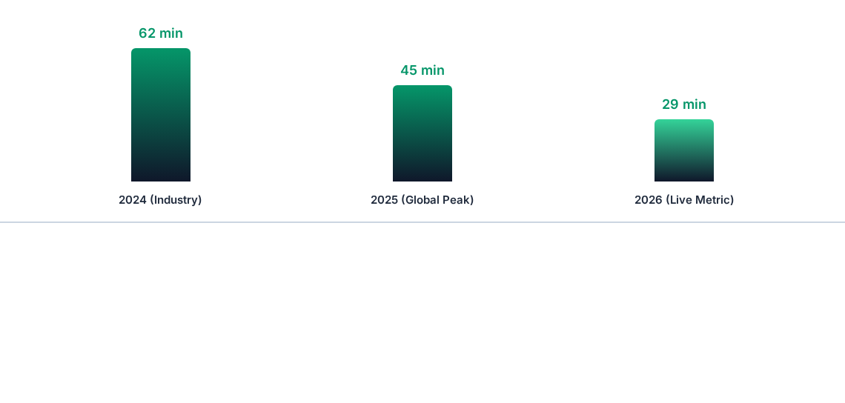
Breakout Speed Dynamics
Data retrieved from key industry reports. Modern eCrime breakout speeds have dropped to an average of just 29 minutes, making automated security essential.
CSKMombasa
Module 3: Threat Intelligence
Slide 22 / 46

Slide 23


Vulnerability Management
1. Discover & Map
2. Assess & Triages
3. Remediate & Verify
Run asset discovery scripts to map software versions, active ports, APIs, and network connections.
Evaluate vulnerabilities using the CVSS framework to differentiate between theoretical bugs and active exploits.
Apply security patches or configuration changes, and re-scan the system to verify successful resolution.
CSKMombasa
Module 3: Threat Intelligence
Slide 23 / 46

Slide 24
CVSS v4.0 Severity Metrics
Base Metric Group
Threat & Environmental Metrics
Evaluates the intrinsic characteristics of a vulnerability that do not change over time or across different deployment environments.
Tailors the raw vulnerability severity score to real-world threats and unique organization configurations.
Threat Metric: Exploitability Status (Unproven, POC, Active)
Attack Vector: Network, Adjacent, Local, Physical
Complexity: Low vs. High difficulty to exploit
Environmental: The critical importance of the affected server asset
Privileges Required: None, Low, or High
CSKMombasa
Module 3: Threat Intelligence
Slide 24 / 46

Slide 25
Vulnerability Prioritization
EPSS Scoring Framework
CISA KEV Catalog
The Exploit Prediction Scoring System utilizes a statistical mathematical model predicting the real probability of a vulnerability being exploited within the next 30 days.
A strictly verified listing of vulnerabilities known to have active, real-world exploitation. This represents immediate, non-negotiable risk.
Uses live threat signals and historical patterns
Mandatory remediation timelines for organizations
Helps prioritize patches before attacks happen
Focuses entirely on active operational threats
CSKMombasa
Module 3: Threat Intelligence
Slide 25 / 46

Slide 26
Vulnerability Scanning
Continuous Scanning: Replace slow monthly scans with ongoing container and cloud-native vulnerability monitoring.
Context-Aware Prioritization: Focus remediation resources on Internet-facing vulnerabilities over isolated internal systems.
Automated Patching Workflows: Streamline software patches using staging environment test runners to prevent service disruption.
Remediation SLAs: Enforce strict remediation deadlines based on CVSS severity (e.g., Critical: 48 hours, High: 14 days).
CSKMombasa
Module 3: Threat Intelligence
Slide 26 / 46

Slide 27
MODULE 04
Enterprise Security Controls and Modern Tools
Deploying layered defensive controls (defense-in-depth) and configuring cybersecurity tools to mitigate risk across the modern organization.

Slide 28





Defense-in-Depth Model
1. Perimeter Defense
2. Endpoint Protection
3. Identity Boundary
Web Application Firewalls (WAF), Next-Generation Firewalls (NGFW), DDOS mitigation layers, and Secure Email Gateways (SEG).
Endpoint Detection and Response (EDR) agents, host-level configuration auditing, local disk encryption, and USB control rules.
Multi-Factor Authentication (MFA), role-based access controls, automated identity provisioning, and strict session limitations.
CSKMombasa
Module 4: Security Controls
Slide 28 / 46

Slide 29
Security Control Tiers
Control Type | Core Definition | Enterprise Implementation Examples
Administrative | Governance, operations policies, compliance regulations, and workforce training programs. | Security awareness training, Acceptable Use Policies (AUP), mandatory background checks.
Technical | Hardware and software configurations deployed directly to protect enterprise computing assets. | MFA enforcement, network firewalls, active IPS, database volume encryption.
Physical | Tactile protective layers deployed to restrict unauthorized physical access to core infrastructure resources. | Biometric server access gates, security guards, CCTV surveillance, environmental fire containment.
CSKMombasa
Module 4: Security Controls
Slide 29 / 46

Slide 30
Zero Trust Architecture
"Never Trust, Always Verify"
ZTA assumes that threats exist everywhere inside the network perimeter, requiring continuous authentication for every user and device.
Continuous Verification: Explicitly authenticate identity, location, and device status.
Least Privilege Access: Limit user access to only the specific applications required for their role.
Assume Breach: Segment network environments to prevent lateral movement of attackers.
CSKMombasa
Module 4: Security Controls
Slide 30 / 46

Slide 31
Modern Identity Frameworks
Identity Threat Detection (ITDR): Deploy identity-centric security to detect credential theft and lateral movement across systems.
Phishing-Resistant MFA: Transition away from vulnerable SMS and email codes to secure FIDO2/WebAuthn hardware keys.
Privileged Access Management (PAM): Restrict administrator accounts to just-in-time, temporary session credentials.
Non-Human Identity Governance: Track and rotate digital credentials used by APIs, automation scripts, and server-to-server systems.
CSKMombasa
Module 4: Security Controls
Slide 31 / 46

Slide 32
Web Application & API Shield
The Explosion of API Risks
WAAP Defense Strategies
Modern application backbones run heavily on microservice APIs, creating highly targeted, unmonitored external attack surfaces.
AI Behavior Profiling: Auto-detect anomalies in API payload patterns.
Strict Bot Mitigation: Block high-volume automated scraping attempts.
Traditional firewalls struggle to parse behavioral API logic.
Rate Limiting: Enforce API access thresholds on a per-client session basis.
Vulnerable to business logic abuse, shadow endpoints, and malicious parameters.
CSKMombasa
Module 4: Security Controls
Slide 32 / 46

Slide 33
MODULE 05
Strategic Incident Response Planning
Developing robust incident response plans to identify, contain, and recover from cybersecurity breaches in alignment with international standards.

Slide 34
Incident Response Severity
Defining Security Incidents
Severity Matrix Classifications
An incident is any event that compromises the confidentiality, integrity, or availability of enterprise systems or networks.
Severity 1 (Critical): Active ransomware, core data breach, or loss of critical systems.
Unauthorized data exfiltration or policy violations.
Severity 2 (High): Compromised endpoint without data leakage, or localized department outage.
Distributed Denial of Service (DDoS) outages.
Severity 3 (Medium/Low): Policy violations without impact, or suspected phishing reports.
CSKMombasa
Module 5: Incident Response
Slide 34 / 46

Slide 35
NIST Response Lifecycle
2. Detection
4. Post-Incident
Analyze system events to identify, validate, and escalate security incidents.
Conduct post-incident reviews to document lessons learned and improve defenses.
1. Preparation
3. Containment
Train response teams, configure system alerts, and document recovery steps.
Isolate compromised systems to prevent the attack from spreading across networks.
CSKMombasa
Module 5: Incident Response
Slide 35 / 46

Slide 36
Incident Prep & Detection
Assembling the CSIRT: Establishing a computer security incident response team with defined technical, legal, and public relations roles.
Alert Configuration: Setting up real-time telemetry alerts on SIEM/EDR platforms to detect anomalous active system behaviors.
Playbook Engineering: Creating pre-configured response playbooks for common attack scenarios like ransomware, phishing, and API abuse.
Dry-Run Simulations: Conducting regular tabletop exercises to ensure business leaders and technical teams understand their roles during an incident.
CSKMombasa
Module 5: Incident Response
Slide 36 / 46

Slide 37
Contain, Eradicate, Recover
Containment & Eradication
System Recovery & Restores
Focuses on stopping system compromise in its tracks and removing threat elements from the network environment.
The systematic restoration of clean, verified systems back into active enterprise production operations.
Short-term Isolation: Disable network switches or isolate virtual systems.
Rebuild servers using hardened golden configurations.
Eradication Actions: Delete malware files, revoke compromised credentials, and close vulnerable ports.
Monitor restored systems closely to detect any recurring malicious activity.
CSKMombasa
Module 5: Incident Response
Slide 37 / 46

Slide 38
Digital Forensics Standards
Preserving Evidence Integrity
During an active breach response, ensuring that all digital evidence is collected in a legally defensible and scientifically sound manner is paramount.
Cryptographic Hashing: Apply MD5 or SHA-256 immediately to verify file copies are identical to the original memory state.
Chain of Custody: Strictly log every handoff of digital storage media to prove the evidence was not modified.
Live Memory Captures: Preserve volatile RAM states before powering down systems.
CSKMombasa
Module 5: Incident Response
Slide 38 / 46

Slide 39
Incident Lessons Learned
“
"A crisis is a terrible thing to waste. The post-incident review represents the most critical, yet frequently ignored stage of response—converting operational scars directly into resilient enterprise architecture."
— Enterprise IR Excellence Guidelines
Ensure post-mortem documentation is completed within 72 hours, tracking root cause analysis, control failures, response gaps, and actionable security updates.
CSKMombasa
Module 5: Incident Response
Slide 39 / 46

Slide 40
MODULE 06
Business Continuity and Disaster Recovery
Designing continuous resilience architectures and disaster recovery strategies to ensure business operations survive high-impact outages.

Slide 41
Business Continuity vs. DR
Metric | Business Continuity (BC) | Disaster Recovery (DR)
Strategic Focus | Ensuring the overall business operation continues during and after a crisis. | The technical process of recovering IT assets, systems, and data after an outage.
Scope | People, physical facilities, workflows, supply chain systems, and business tools. | IT infrastructure, data backups, networks, database replication, and system servers.
Active Phase | Triggered immediately during a major incident (e.g., working from home during a flood). | Triggered following system downtime to restore operations (e.g., restoring backups).
Key Metrics | Overall system uptime and continuity metrics. | RTO (Recovery Time) and RPO (Data Loss Window).
CSKMombasa
Module 6: BCDR
Slide 41 / 46

Slide 42
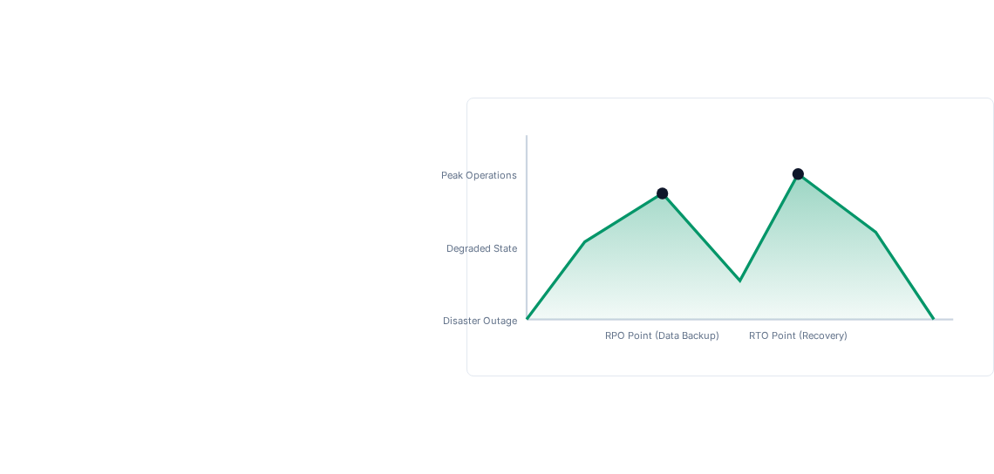
Visualizing Recovery Metrics
Key Operational Goals
These core metrics determine how quickly system recovery must occur and define the maximum acceptable amount of data loss.
RTO (Recovery Time Objective): The target duration of time to restore systems after an outage.
RPO (Recovery Point Objective): The maximum age of data that must be recovered from backup storage (defines backup frequency).
CSKMombasa
Module 6: BCDR
Slide 42 / 46

Slide 43





BCDR Lifecycle Framework
1. Business Impact Analysis
2. Testing & Exercises
3. Continuous Updates
Run simulated system failovers, table-top scenarios, and live data restorations under stress to verify plan viability.
Review and update disaster recovery plans regularly based on new infrastructure deployments and software updates.
Assess critical business workflows and map system dependencies to identify potential single points of failure.
CSKMombasa
Module 6: BCDR
Slide 43 / 46

Slide 44
Disaster Recovery Sites
Hot Site (Active-Active)
Cold Site (Passive Restore)
A mirror copy of active data systems operating in real-time, providing near-instantaneous business failovers.
An empty backup facility with essential infrastructure but no pre-configured active systems. Data must be manually restored.
RTO: Minutes / RPO: Near-zero
Very high operational cost and maintenance overhead
RTO: Days / RPO: Dependent on latest backup
Low maintenance cost; ideal for non-critical systems
CSKMombasa
Module 6: BCDR
Slide 44 / 46

Slide 45
Executive Program Takeaways
Cryptographic Defense: Secure all data at rest and in transit, and prepare for post-quantum cryptographic transitions.
Risk Management: Align qualitative and quantitative assessments to support cybersecurity business cases.
Proactive Threat Hunting: Integrate actionable threat intelligence to detect attacks before they occur.
Resilience First: Maintain well-tested Incident Response and BCDR plans to recover quickly from unavoidable outages.
CSKMombasa
Executive Program Takeaways
Slide 45 / 46

Slide 46


Questions & Answers
Advanced Cybersecurity & Enterprise Resilience Strategy
info@csk.or.ke | www.csk.or.ke
Computer Society of Kenya © 2026. All Rights Reserved.

